Slide 1

EE 463 Hardware Project
DC Motor Driver Term Project
Presented by:
Mert Sevim
Kaan Özsoy
Polat Öztürk

Slide 2
Introduction & Project Objectives
Goal: Design a power electronic driver for a DC motor.
Adjustable DC output up to 180 V.
Input: 3‑phase AC Voltage.
Ripple frequency requirement: f_{ripple} > 1 kHz.
Simulations verify performance; components finalized.

Slide 3
Topology Selection
Selected Topology: 3‑Phase Diode Rectifier + Buck.
Provides ~520 V stable DC bus, high reliability, low cost and easy to implement

Slide 4
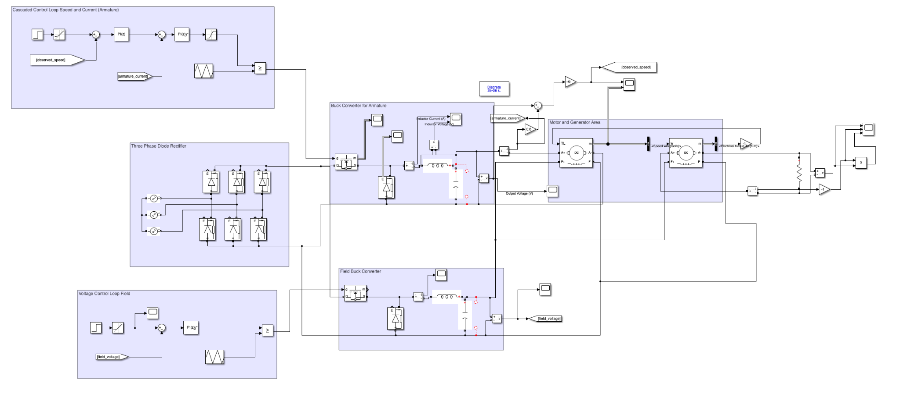
System Overview
3‑Phase rectifier converts 380 V AC → ~520 V DC.
Buck converter regulates 0–180 V DC.
Motor‑generator pair simulates load.
17 Ω load connected to generator output.

Slide 6
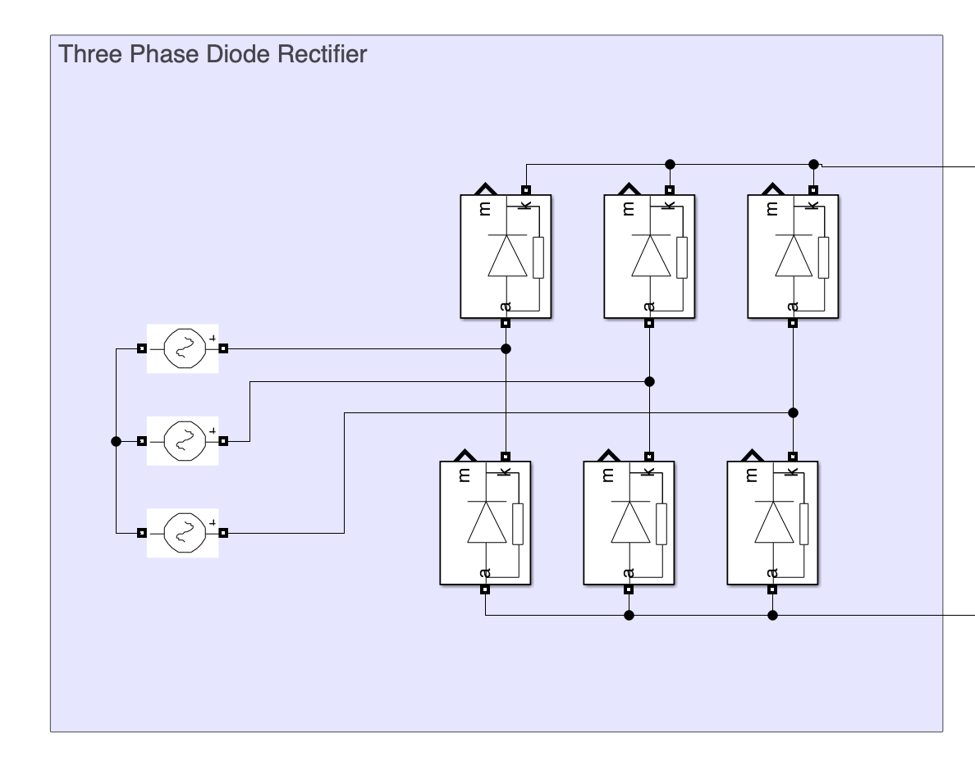
Simulation: Rectifier Stage
Input 380 V_LL → peak diode voltage ~540 V.
Average output ~530 V DC.
Max diode current < 60 A.
Defines minimum ratings for rectifier hardware.

Slide 7
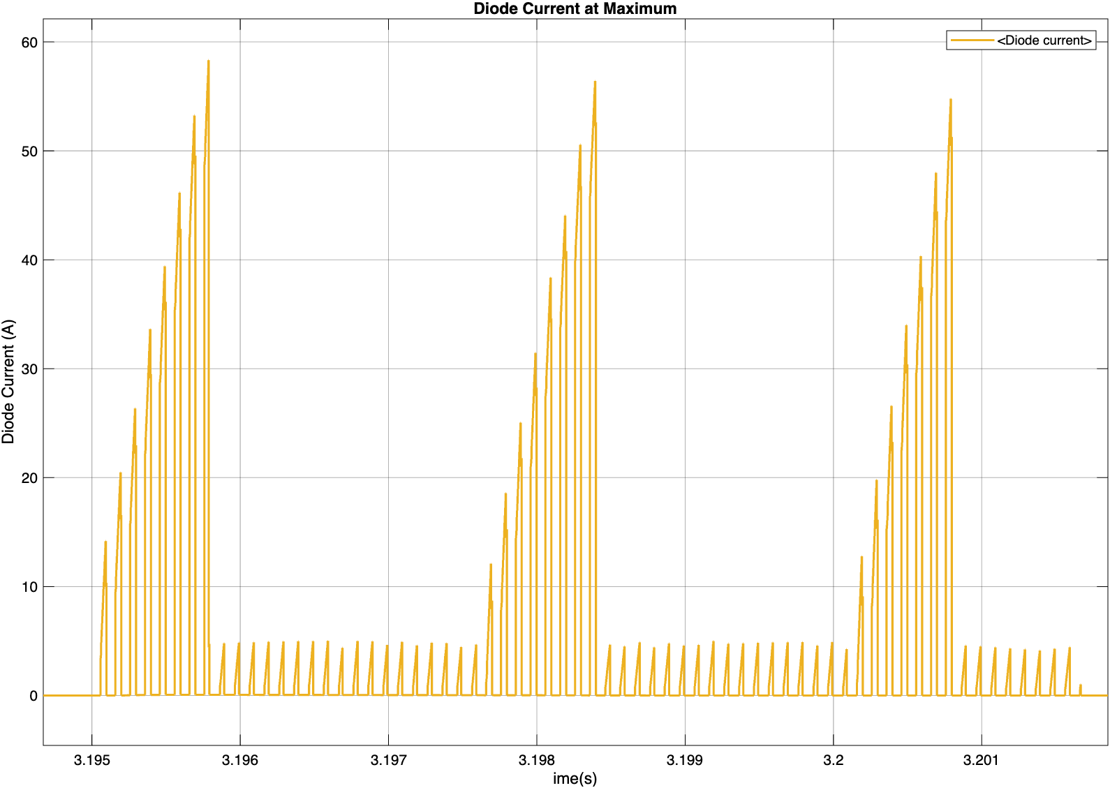
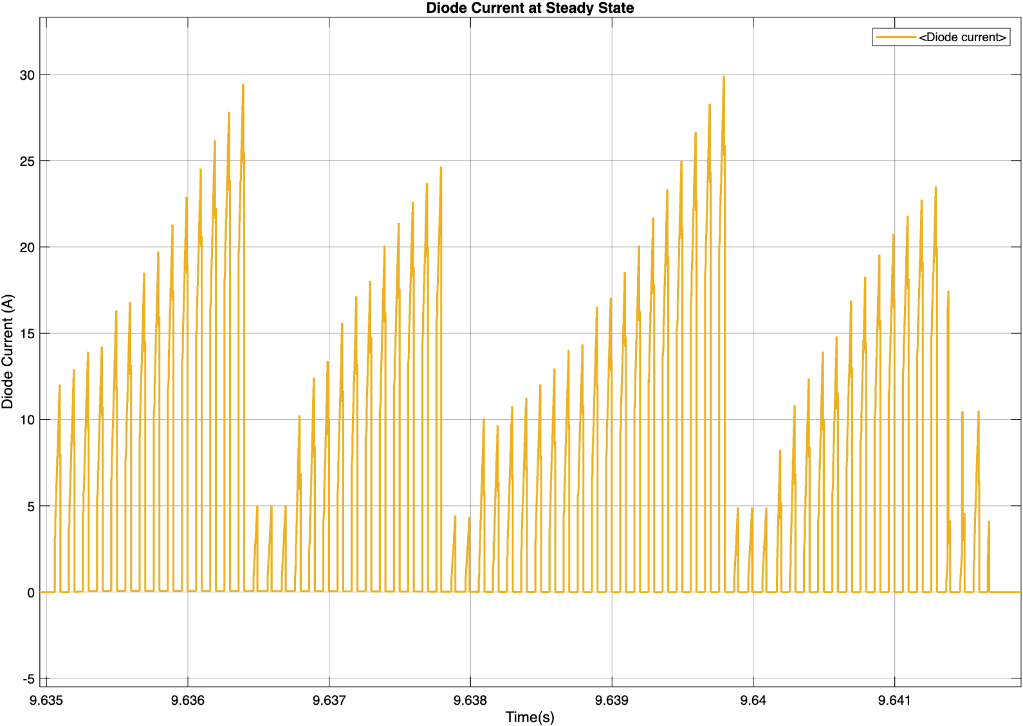
Diode current at maximum
Diode current at steady state

Slide 8
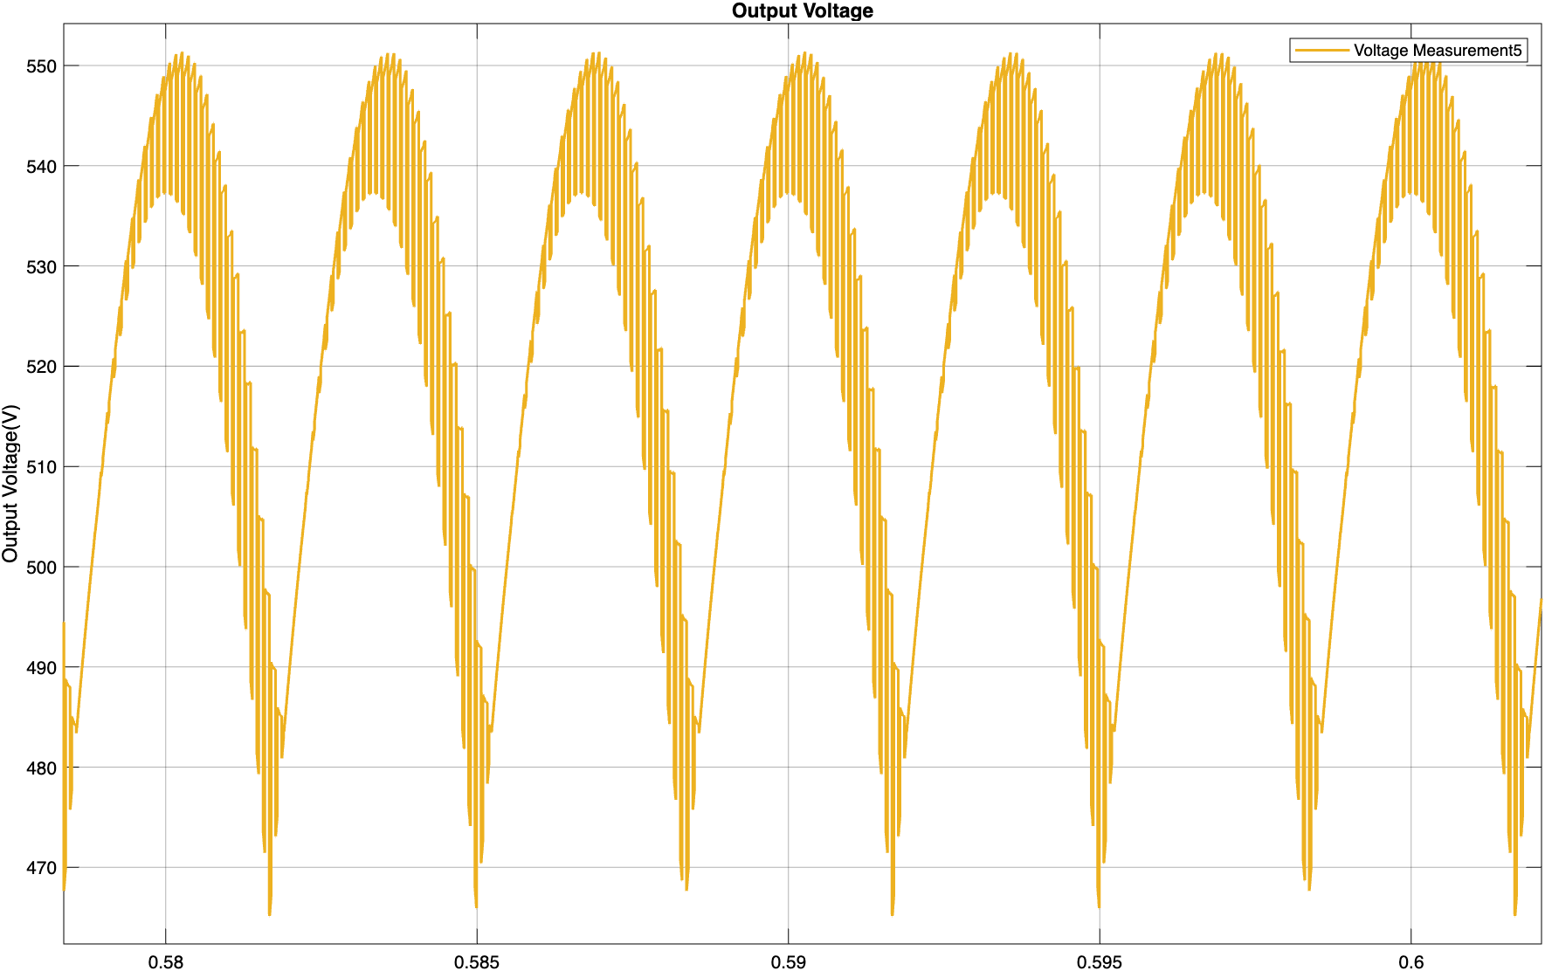
Output current

Slide 9
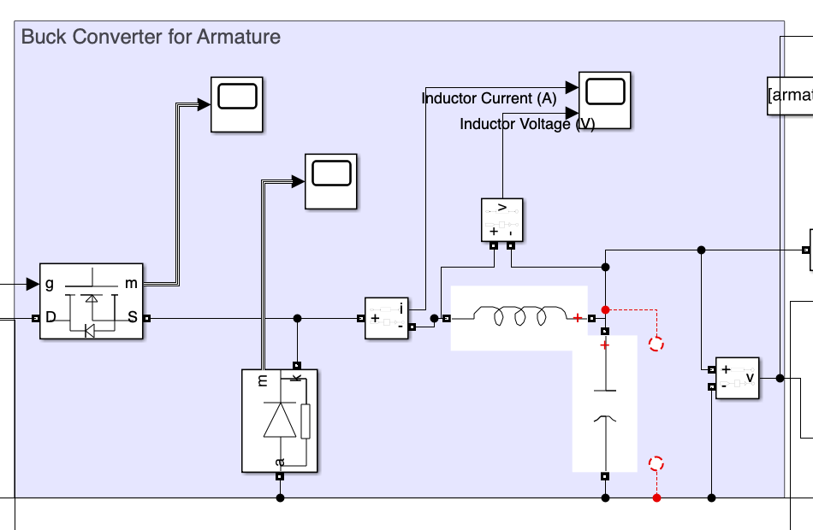
Simulation: Buck Converter Stage
Switching frequency: 10 kHz.
L = 2.2 mH, C = 470 μF.
Voltage ripple < 1%.
Inductor: 0–20 A current, –170 to 370 V voltage swing.

Slide 10
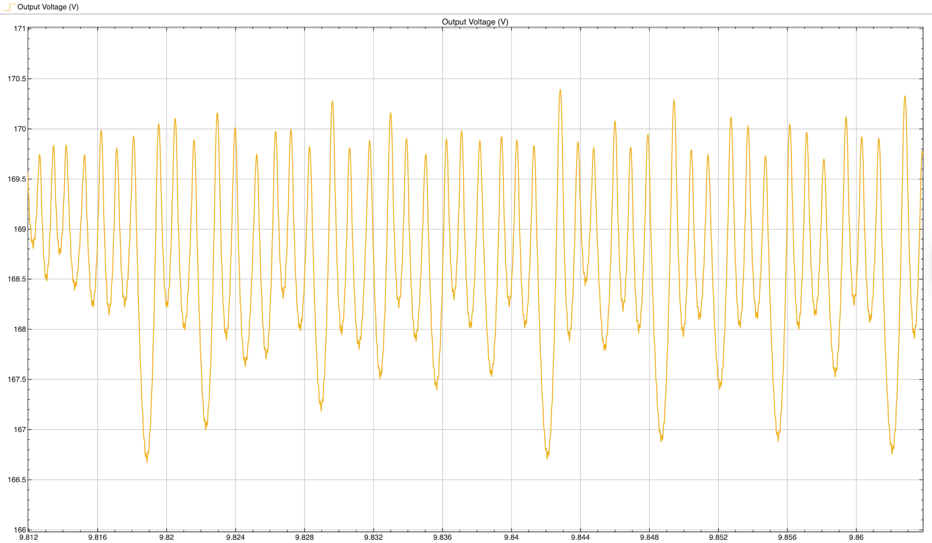
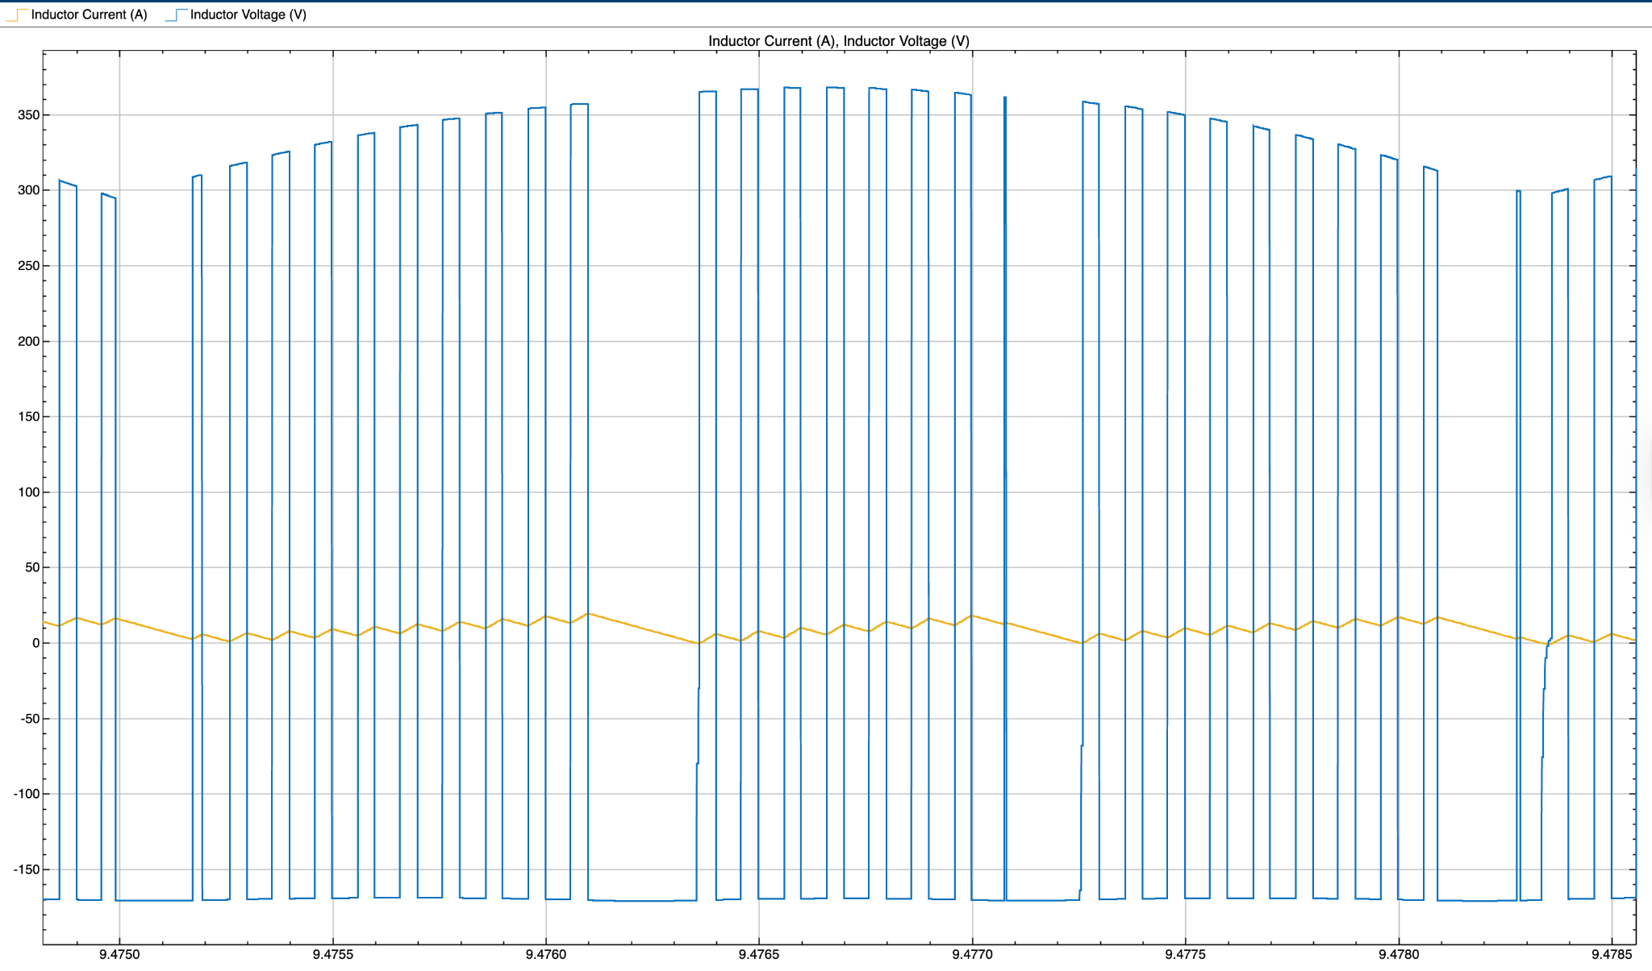
Output Voltage Waveform of Buck Converter
Voltage and Current Waveform of Inductor

Slide 11
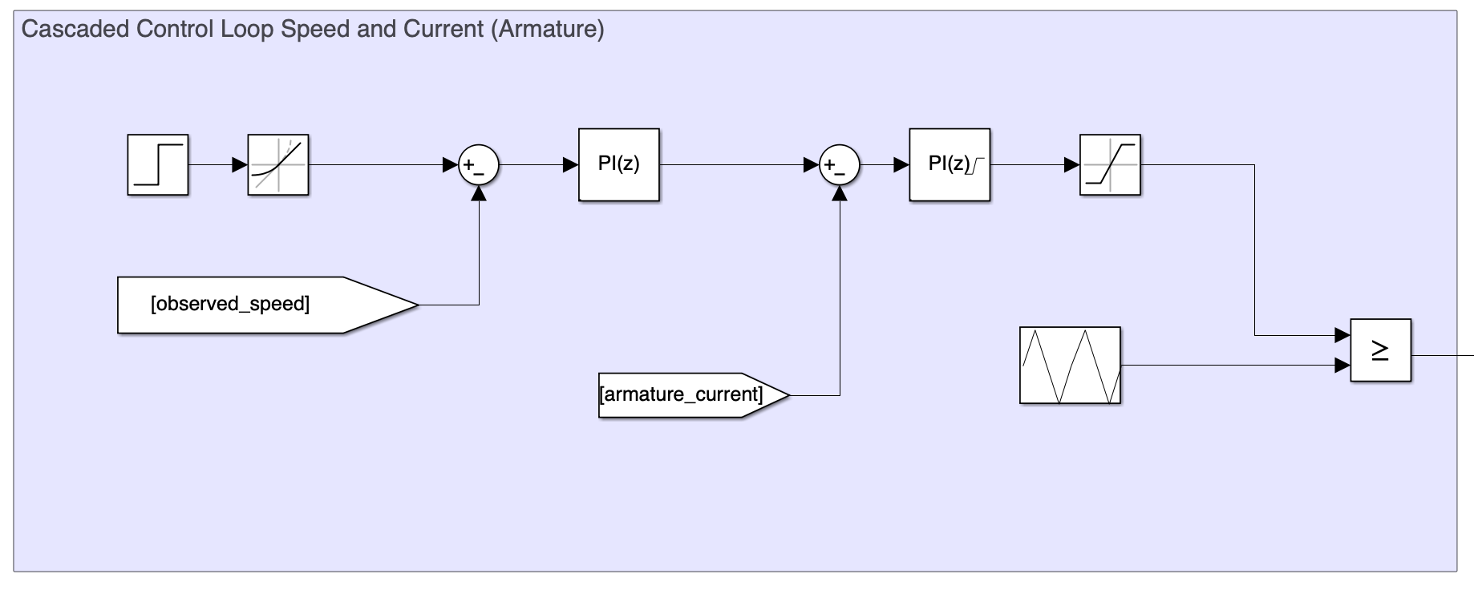
Control Strategy (Cascaded Loops)
Speed loop: speed_{ref} – speed_{measured} → I_{a,ref}.
Current loop: I_{a,ref} – I_{a} → V_{a,ref}.
PWM: Converts V_{a,ref} to duty ratio at 10 kHz.
Field PI loop regulates field voltage to 180 V.
Soft start via ramped references.

Slide 12
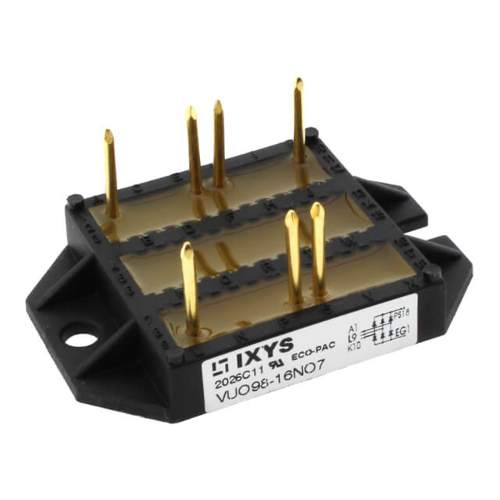
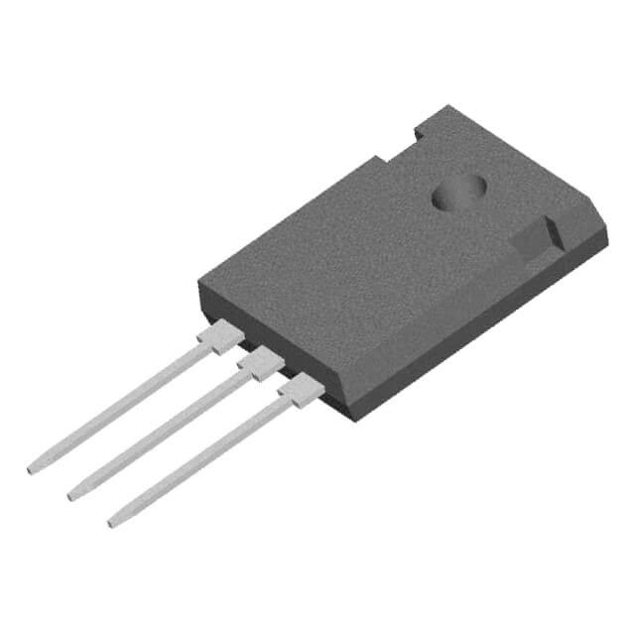
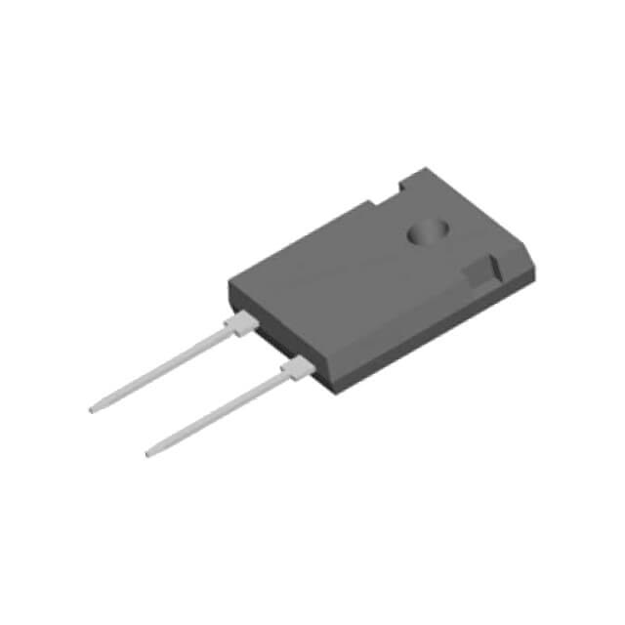
Component Selection (Power Stage)
Rectifier: VUO98‑16NO7 (1600 V / 105 A).
MOSFET: IXFH80N65X2 (650 V / 80 A).
Freewheeling diode: DSEI30‑06A (600 V / 30 A).
Ratings selected for safety margins and fast switching.
VUO98-16NO7 3-phase full bridge rectifier
IXFH80N65X2 N-Channel Power MOSFET
DSEI30-06A freewheeling diode

Slide 13
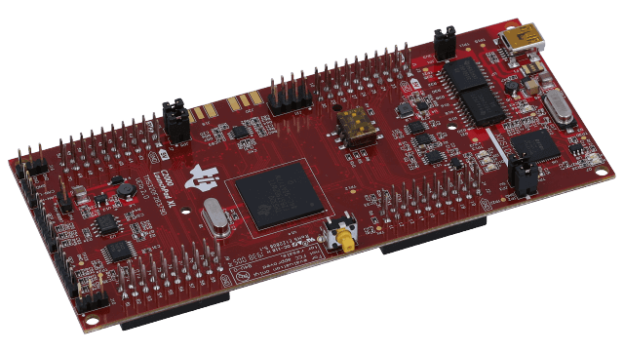
Microcontroller & Sensing
MCU: TI LAUNCHXL‑F28379D for PWM and PI loops.
Voltage divider: 550 kΩ / 10 kΩ reduces 180 V to ~3.21 V.
Isolation amplifier: TI AMC1200.
Current sensing: ACS758lcb Hall‑effect sensor.

Slide 14
Conclusion & Bonus Goals
Stable DC output with <1% ripple.
Simulation achieved 1.4 kW; target 1.6 kW.
Supports Tea Bonus and Single‑Supply Bonus.
Awaiting hardware feedback for final implementation.

